Slide 1
Employee Attrition Analysis USING EXCEL
student Name : moinsha. S
Register number:31221733
Department :BCOM general A
CollEGe:: thiruthangal nadar college

Slide 2
Project title
Employee Attrition Analysis Using Excel

Slide 3
AGENDA
Problem Statement
Project Overview
End Users
Dataset Description
Modelling Approach
Results and Discussion
Conclusion

Slide 4
PROBLEM STATEMENT
- Title: “Employee Attrition: A Growing Concern” - Description: Briefly explain the issue of employee attrition, its impact on organizations, and the need for analysis.

Slide 5
PROJECT OVERVIEW
Title: “Employee Attrition Analysis Project” Description: Outline the project’s objectives, scope, and timeline.

Slide 6
End users
Title: “Stakeholders and End Users” Description: Identify the stakeholders and end users of the analysis, such as HR, management, and employees.

Slide 7
OUR SOLUTION AND ITS VALUE PROPOSITION
Title: “Predictive Analytics for Employee Attrition Description: Explain how predictive analytics can help identify factors contributing to attrition and inform retention strategies

Slide 8
Dataset Description
Title: “Employee Data Overview” Description: Describe the data used for analysis, including: - Data sources - Variables (demographics, job details, performance metrics, etc.) - Data quality and preprocessing steps

Slide 9
Modelling Approach
Title: “Modelling Employee Attrition” Description: Outline the modelling approach, including: - Logistic regression - Decision trees - Survival analysis - Model evaluation metrics (accuracy, precision, recall, etc.)

Slide 10
RESULTS
S. No | FIRST NAME | LAST NAME | DOB | TITlE | DIVISION | DEPARTMENT | PERFORMANCE SCORE | CURRENT EMPLOYEE RATING
1 | Uriah | Bridges | 07-10-1969 | Production Technician I | Finance & Accounting | Production | Fully Meets | 4
2 | Paula | Small | 30-08-1965 | Production Technician I | Aerial | Production | Fully Meets | 3
3 | Edward | Buck | 06-10-1991 | Area Sales Manager | General - Sga | Sales | Fully Meets | 4
 | Michael |  | 04-04-1998 | Area Sales Manager | Finance & Accounting | Sales | Fully Meets | 2
5 | Jasmine | Onque | 29-08-1969 | Area Sales Manager | General - Con | Sales | Fully Meets | 3
6 | Maruk | Fraval | 03-04-1949 | Area Sales Manager | Field Operations | Sales | Fully Meets | 3
7 | Latia | Costa | 01-07-1942 | Area Sales Manager | General - Eng | Sales | Exceeds | 4
8 | Sharlene | Terry | 07-03-1957 | Area Sales Manager | Engineers | Sales | Fully Meets | 2
9 | Jac | McKinzie | 15-05-1974 | Area Sales Manager | Executive | Sales | Exceeds | 3
10 | Joseph | Martins | 11-11-1949 | Area Sales Manager | Engineers | Sales | Fully Meets | 5
Table:

Slide 11
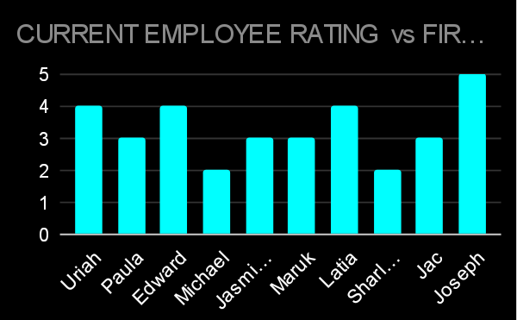
Par chart

Slide 12
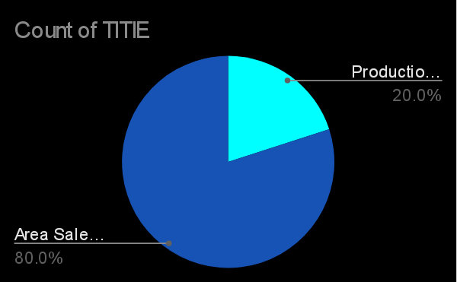
Pie chart:

Slide 13
Conclusion
Title: “Conclusion and Recommendations” Description: Summarize key findings, implications, and recommendations for retention strategies

